Slide 1
EASIER AND MORE ACCURATE DATA COLLECTION
FASTER DATA TRANSFER
REAL-TIME DECISION-MAKING

Slide 2
MONITORING & EVALUATION IN CRS’ STRATEGY
Monitoring, evaluation, accountability, and learning (MEAL) and ICT4D are critical to CRS’s
5-year strategy

Slide 3
WHY E-VALUATE?
Easier and more accurate data collection
Better efficiency for MEAL data collection and reporting
More transparency and accountability
Better tools for decision making and service delivery
Easier performance tracking across projects, countries and regions

Slide 4
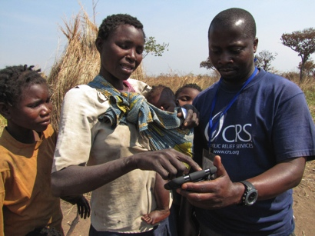
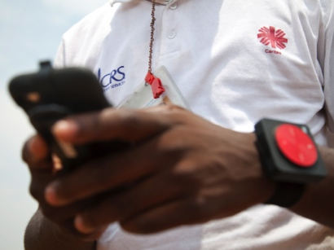
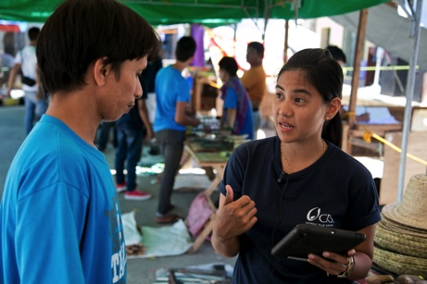
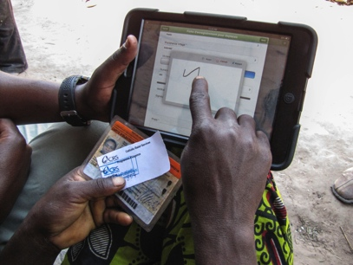
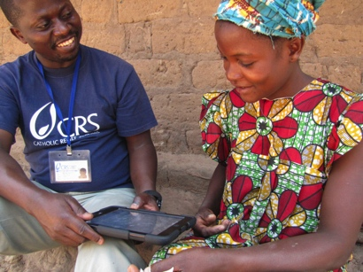
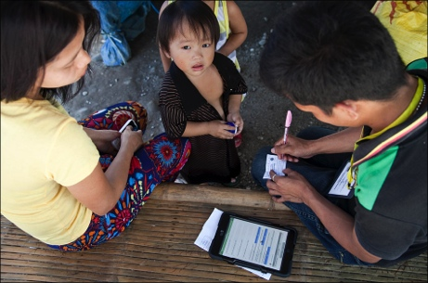
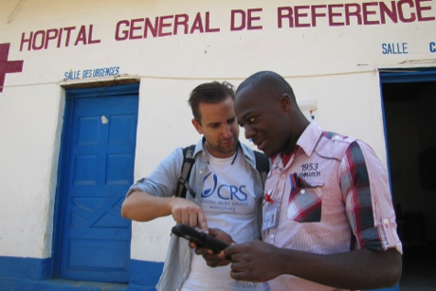
REAL EXPERIENCE
CRS has five years of experience using mobile devices for MEAL in over 100 projects across Africa, Asia, Latin America and the Middle East.

Slide 5
REAL SUCCESS STORIES
THE GREAT LAKES CASSAVA INITIATIVE
NATIONAL SCALE HEALTH SURVEY
REAL-TIME ASSESSMENTS
SEED FAIRS
A food-security project in six countries in Africa helped 1.15 million farmers, armed 250 field agents with laptops
In CAR, Madagascar and Rwanda we achieved a 75% savings in labor over paper-based data collection systems
In Sierra Leone, registered over 36,000 people and completed analysis of the results in three months
Following cyclones in Madagascar, we ensured that we delivered the right materials to affected people

Slide 6
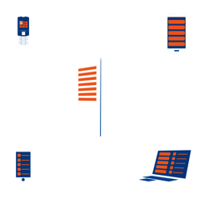
HOW E-VALUATE WORKS
1
4
FORM LIBRARY
using standardized customizable forms
REPORTS & MAPS
provides up-to-date information for evaluation
2
5
COLLECT DATA
with mobile devices utilizing GPS
SECURE SHARING
of data utilizing an online portal
3
6
MANAGE DATA
in a secure centralized location
ANALYSIS, DECISION MAKING & ACTION
aggregate data, identify trends, perform analyses

Slide 7
1. FORM LIBRARY
Complements typical processes for project design
Reusable forms
Forms can be quickly tailored
SMILER WORKSHOP
Identifies form and reporting needs
FORM LIBRARY
Standard data collection forms
FIT GAP ANALYSIS
Identifies forms to be updated, customized, or created
PROJECT SPECIFIC FORMS
A combination of standard, customized and new forms

Slide 8
2. COLLECT DATA
Mobile devices preloaded with project forms
GPS used to geocode the data
Barcode scanners read ID cards provided to beneficiaries
Data collectible online and offline
Data transmitted to a secure database
SMART PHONE OR TABLET
SOLAR BACKPACK
CHARGER
EXTERNAL GPS
MINI SERVER
BARCODE SCANNER
SMS ALTERNATIVE

Slide 9
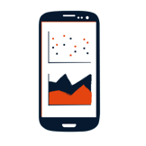
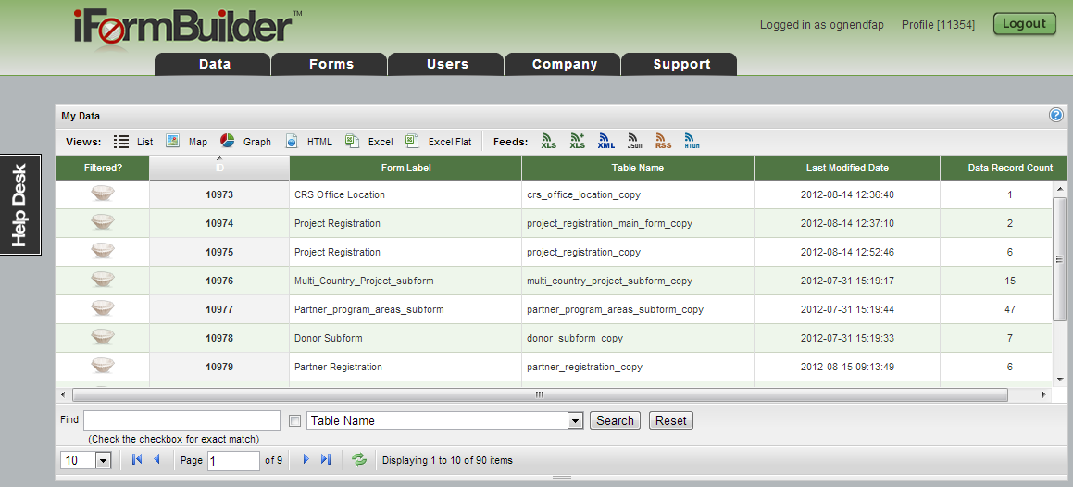
3. MANAGE DATA
Each project has a dedicated database
High standards for privacy and security
Users can access, clean and manage data online

Slide 10
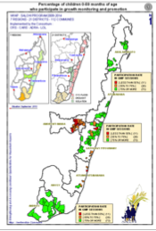
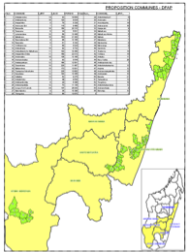
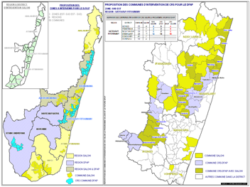
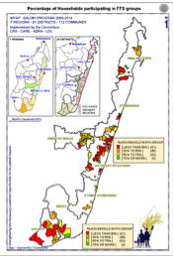
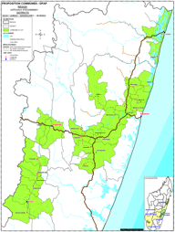
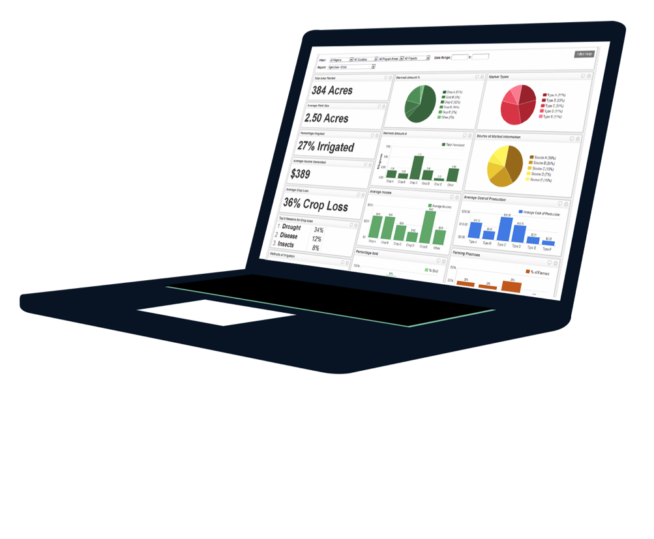
4. REPORTS & MAPS
Aggregate and summarize data
Identify trends
Perform statistical analyses
Create dashboards and maps

Slide 11
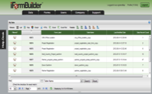
5. SECURE SHARING
Online portal allows stakeholders to access the data, dashboards, reports and maps
Platform uses secure, role-specific permissions
DECISION MAKERS
USERS
BENEFICIARIES

Slide 12
6. ANALYSIS, DECISION MAKING & ACTION
Up-to-date numbers on beneficiaries and services delivered
Detailed information on performance across projects
Ability to evaluate the efficiency and impact of programs and make decisions accordingly

